Slide 1

Part 2
Strategy and applications
Chapter 5
Digital business strategy
Part-2

Slide 2
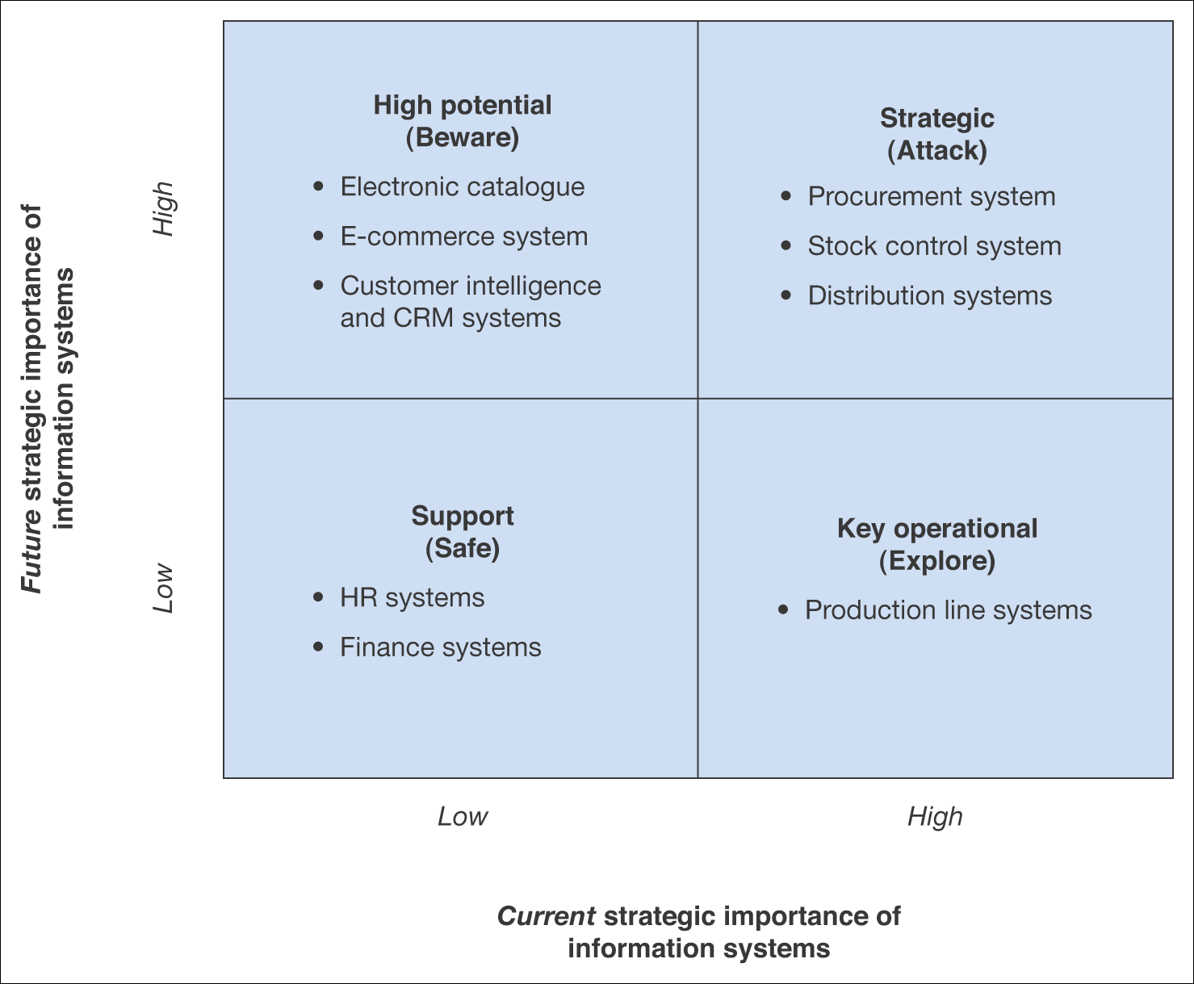
Figure 5.7 Summary applications of a portfolio analysis for an example B2B company

Slide 3
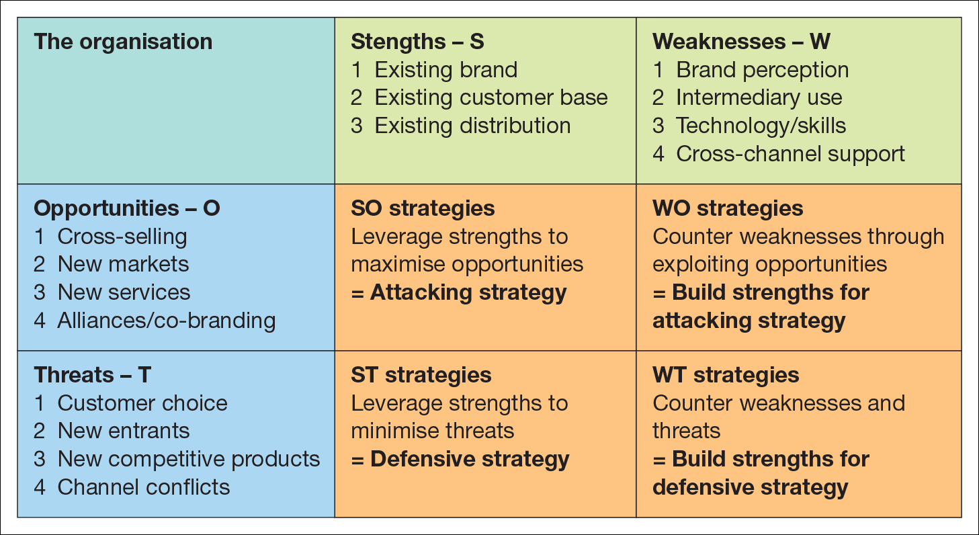
Organisational and IS SWOT analysis
SWOT/TOWS analysis, with strategies to counter the threats

Slide 4
Human and financial resources
Resource Analysis will also consider the two factors:
HR – To take advantage of the opportunities identified in strategic analysis, the right resources must be available to deliver digital business solutions.
Financial resources – Assessing financial resources for information systems is usually conducted as part of investment appraisal and budgeting for enhancements to new systems.
Evaluation of internal resources should be balanced against external resources.

Slide 5
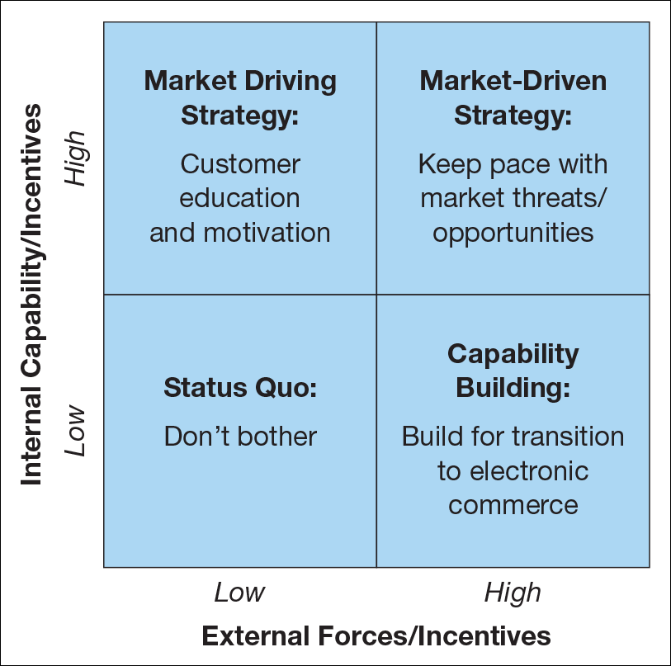
Market Driving Strategy is often the situation for the early adopters
Capability Building is for later adopters
Figure 5.9 Matrix for evaluation of external capability against internal capability
Source: Perrott (2005).

Slide 6
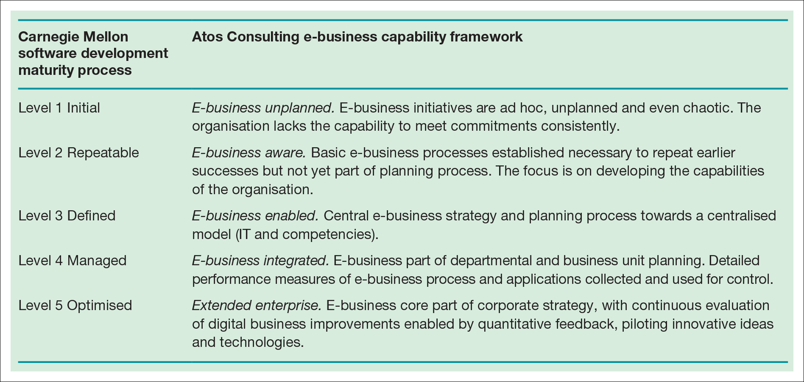
Capability maturity model of the adoption of e‑business

Slide 7
Competitive environment analysis
External factors are also assessed as part of strategic analysis
Demand Analysis
Assessment of the demand for e-commerce services amongst existing and potential customer segments
Is a key activity in producing a digital marketing plan
Competitive Threats
Threat of new e-commerce entrants
Threat of new digital products
Threat of new business models

Slide 8
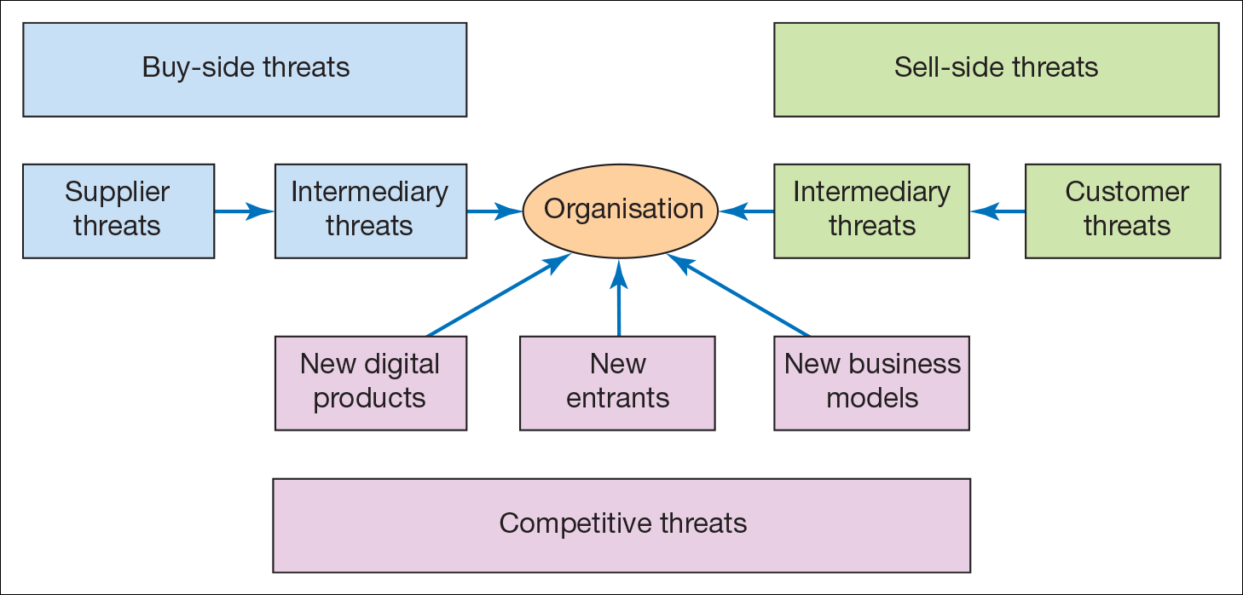
Sell-side threats:
Customer threats: power and knowledge
Intermediary threats: Potential loss of partners and distributors
Buy-side threats:
Supplier threats: Soft-lock-in
Intermediary threats: Costs of integration, increase in commission once established
Figure 5.10 Competitive threats (Michael Porter) acting on the digital business

Slide 9
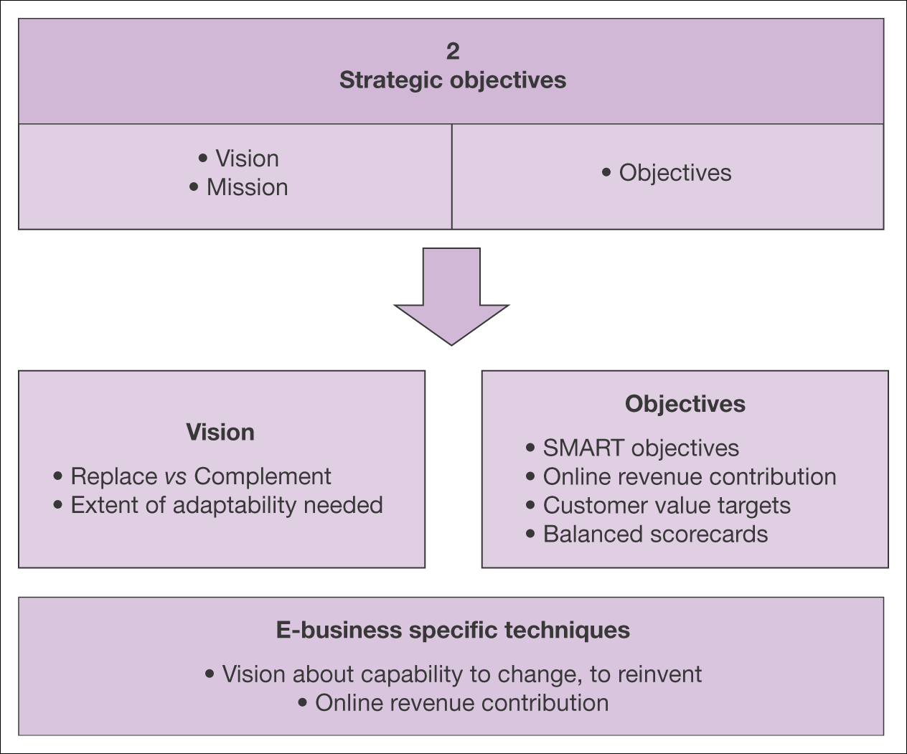
Figure 5.11 Elements of strategic objective setting for the digital business

Slide 10
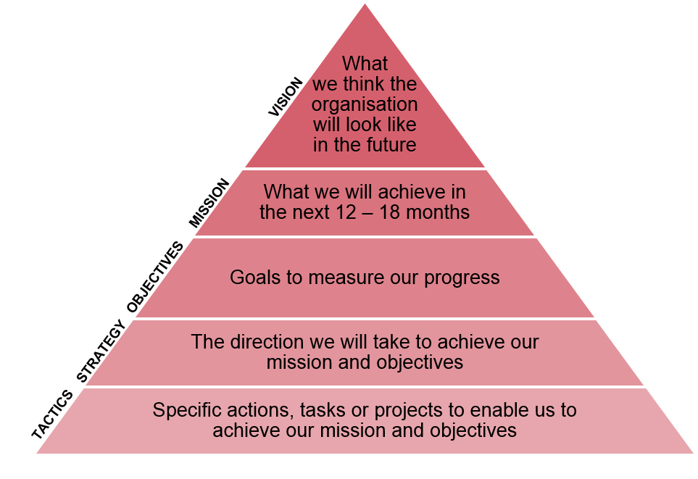
Figure 5.13 VMOST analysis
A good starting place for any business is to do VMOST analysis, a simple model that can be used to outline key elements of the business and help determine strategy

Slide 11
Strategic Objectives
Organisation’s strategic objectives is a key element of any strategy process model because:
Strategy definition and implementation elements of strategy must be directed at how best to achieve the objectives
The overall success will be assessed by comparing actual results against objectives and taking action to improve strategy
Clear, realistic objectives help communicate the goals and significance of a digital business initiative to. employees and partners

Slide 12
Strategic Objectives - How can digital business create business value?
Adding value
Incremental value is delivered through providing better-quality products and services to an organisations customers.
Information can be used to better understand customer preferences.
Example, personal recommendations by Amazon
Reduce costs
Cost reduction is achieved through making the business processes more efficient
Manage risks
Risk management is a well-established use of information within organisations. Ex, finance, auditing
Create new reality – Innovation and creativity

Slide 13
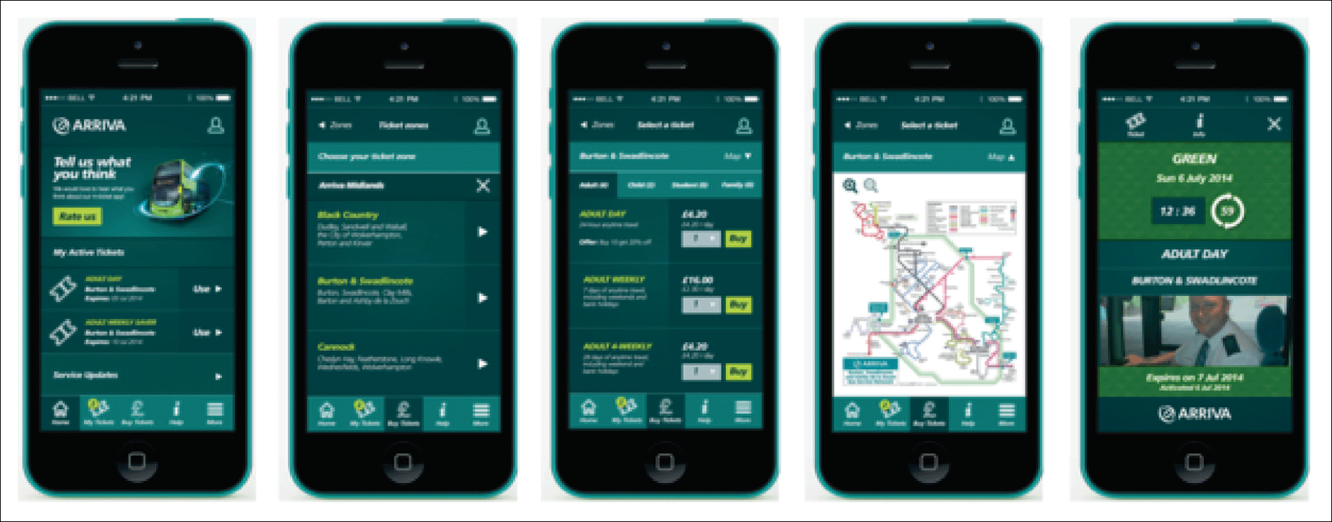
Figure 5.14 Arriva Bus app

Slide 14
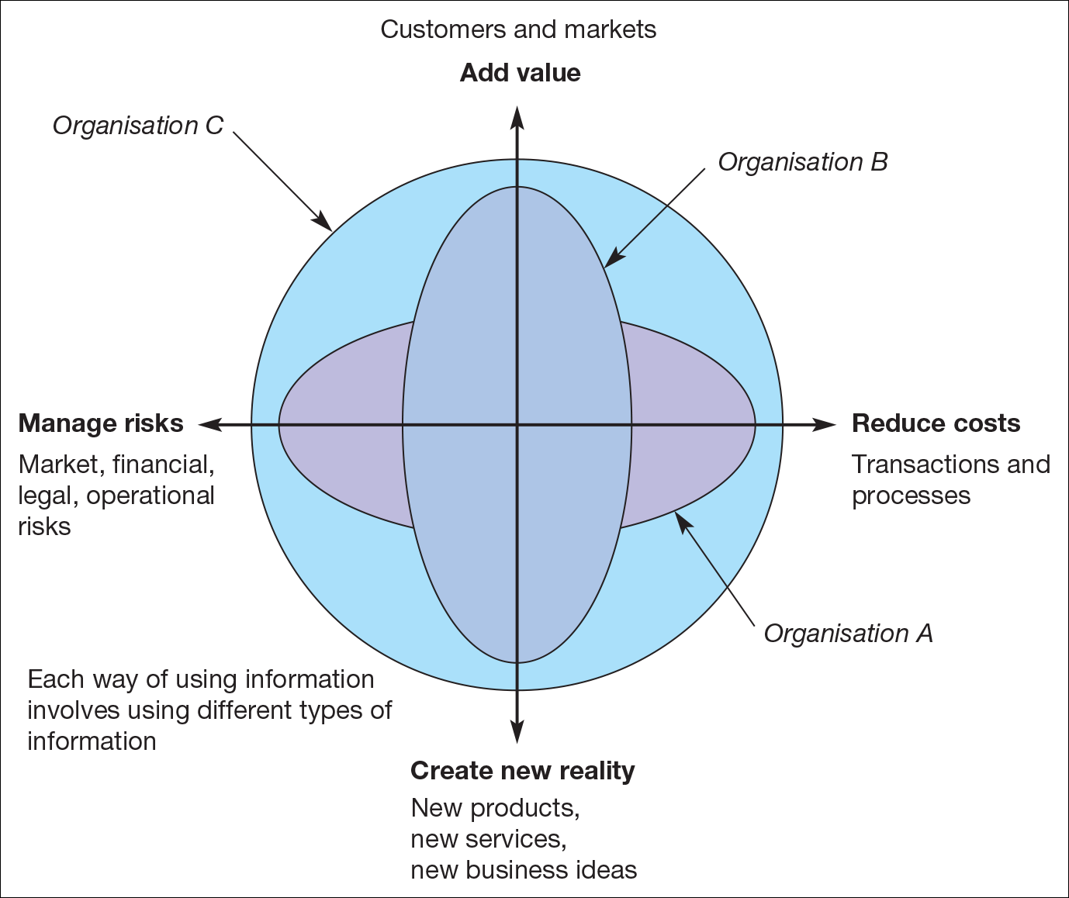
An evaluation tool relating information to business value. An organisation’s use of information on each axis can be assessed from 1 (low use of information) to 10 (high use of information)
Source: Marchand et al. (1999).

Slide 15
Objective Setting
An effective strategy development process links general goal, strategies and more specific objectives and performance measures.
One method of achieving this is tabulating goals, strategies to achieve goals and KPIs
All the objectives must follow SMART criteria to include both efficiency and effectiveness.
Efficiency – minimizing resources or time needed to complete a process: doing the thing right
Effectiveness – Meeting process objectives, delivering the required outputs and outcomes: doing the right thing

Slide 16
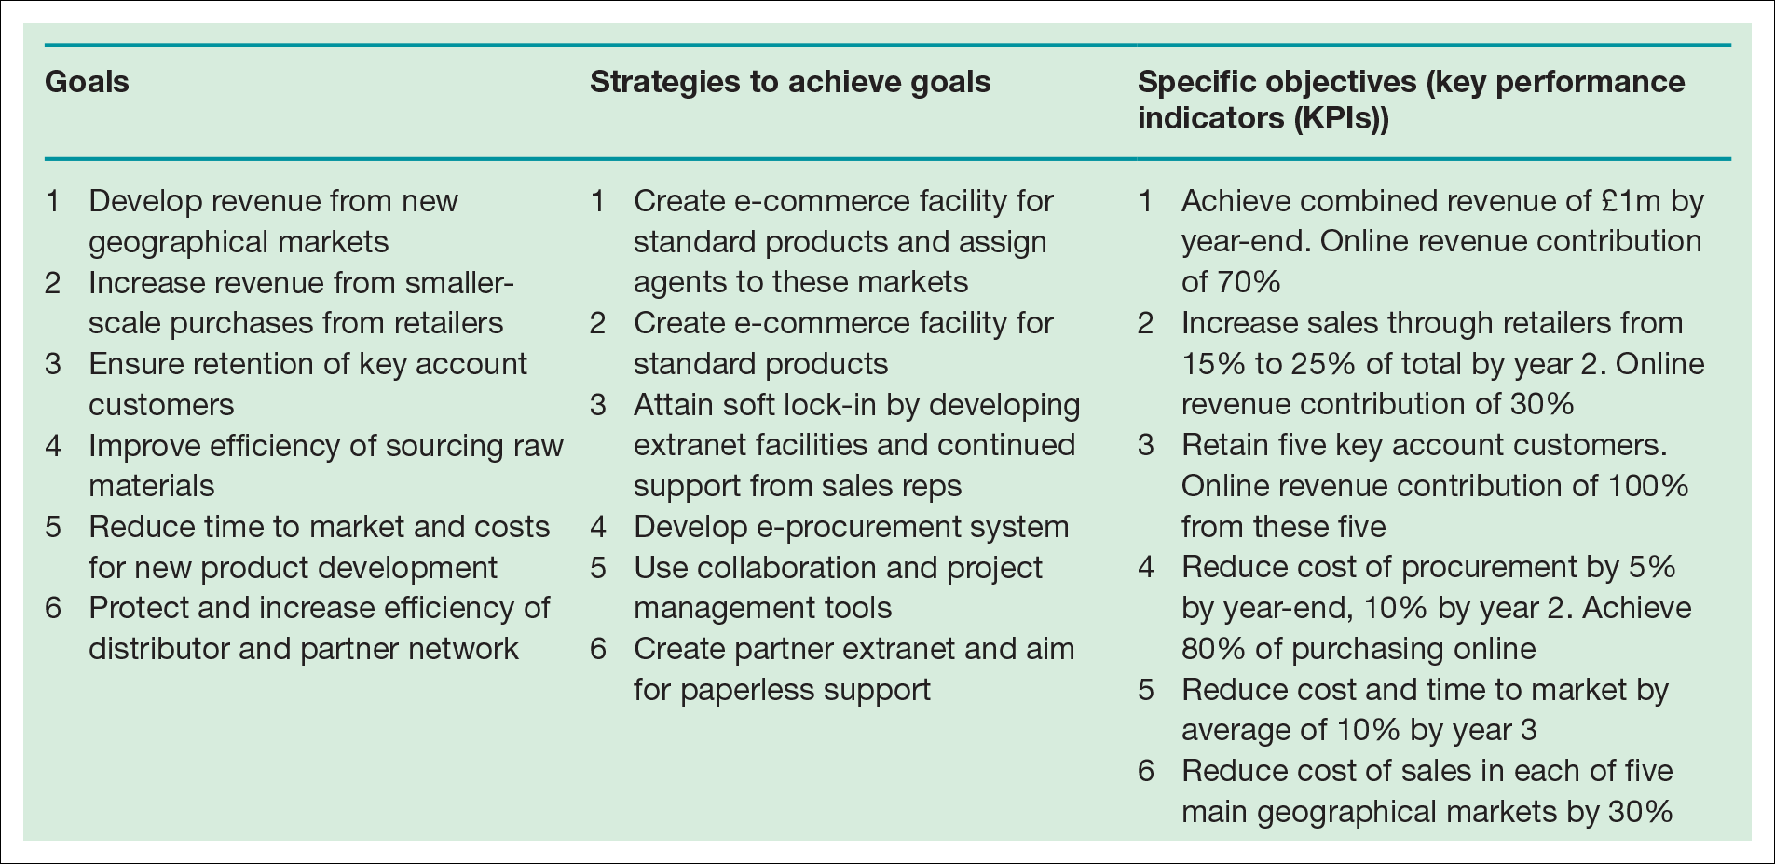
Goals, strategies and objectives, performance indicators for an example B2B company (in order of priority)

Slide 17
Objective setting
Online Revenue Contribution(ORC)
This states the percentage of company revenue directly generated through online transactions.
ORC can be set as an objective
Indirect ORC is where the sale is influenced by the online presence, but purchase occurs using conventional channels.
ORC can be set for different digital channels such as web or mobile commerce
Conversion marketing
Using marketing communications to maximise conversion of potential customers to actual customers.

Slide 18
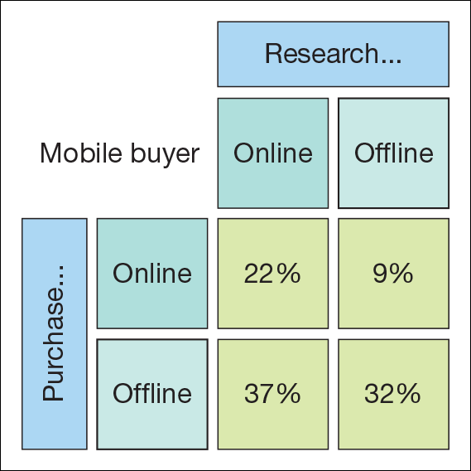
Research Online Purchase Offline example(ROPO) Source: Google.

Slide 19
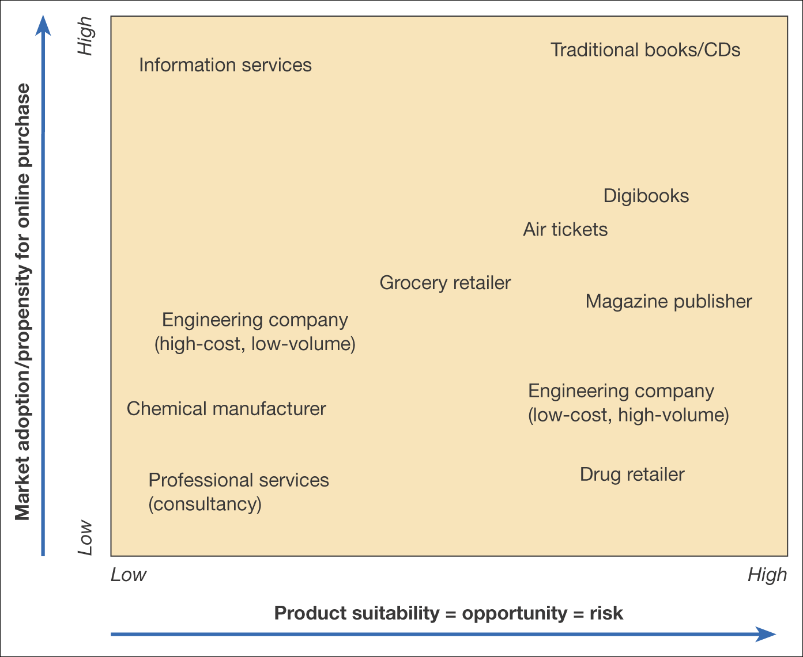
Figure 5.16 Grid of product suitability against market adoption for transactional e-commerce (online purchase)

Slide 20
Balanced Scorecard
Balanced Scorecard is a metrics/framework widely used as a means of translating organisational strategies into objectives and then providing metrics to monitor the execution of the strategy.
The main areas of the balanced scorecard are:
Customer concerns – These include time, quality, performance, service and cost. Example, Halifax mystery shoppers
Internal measures – Based on the business processes that have the greatest impact on customer satisfaction. Example, Halifax ATM availability
Financial measures – traditional measures such as turnover, costs, profitability and return on capital. Example, Halifax gross receipts, mortgage offers, loans
Learning and growth – Innovation and staff development.

Slide 21
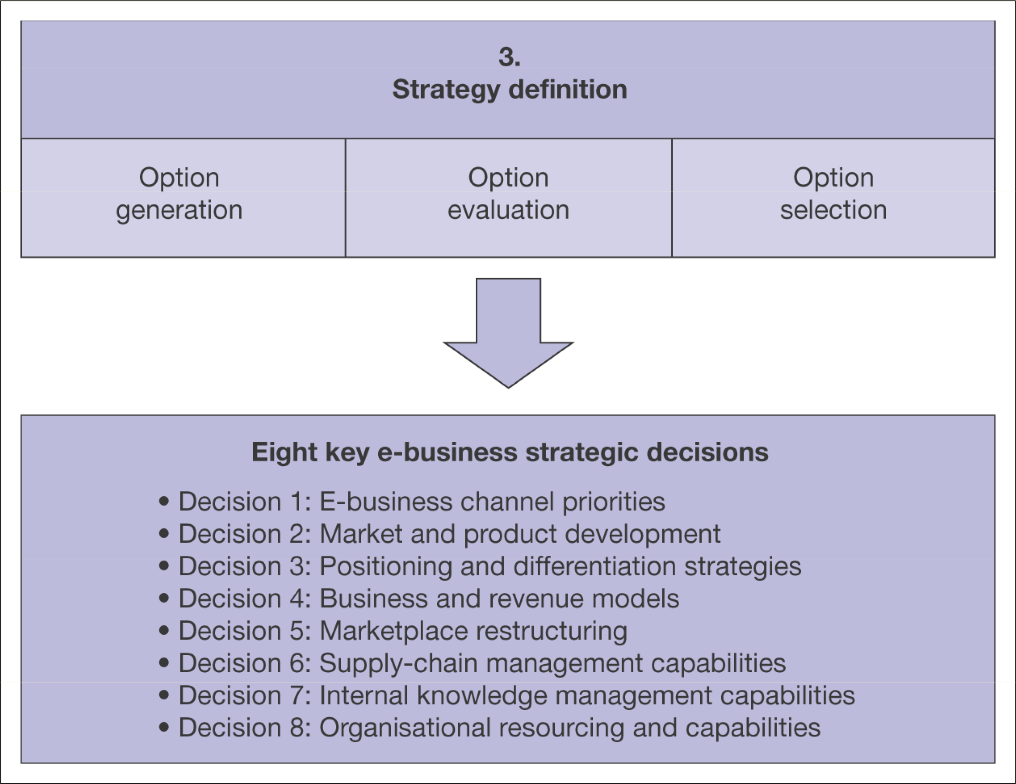
Strategy Definition:
Formulation, review and selection of strategies to achieve strategic objectives.
This is driven by the objectives and vision referred to in the previous sections.
Strategy is formulated based on vision and objectives, so it is necessary to frequently revisit and revise them
Figure 5.17 Elements of strategy definition for the digital business
Notes:
D1:Sell-side down stream(B2C) or Buy-side up stream.(B2B). For a multichannel businesses with offline and online stores, getting the right mix of ‘bricks and clicks’ as shown in the next slide
D2

Slide 22
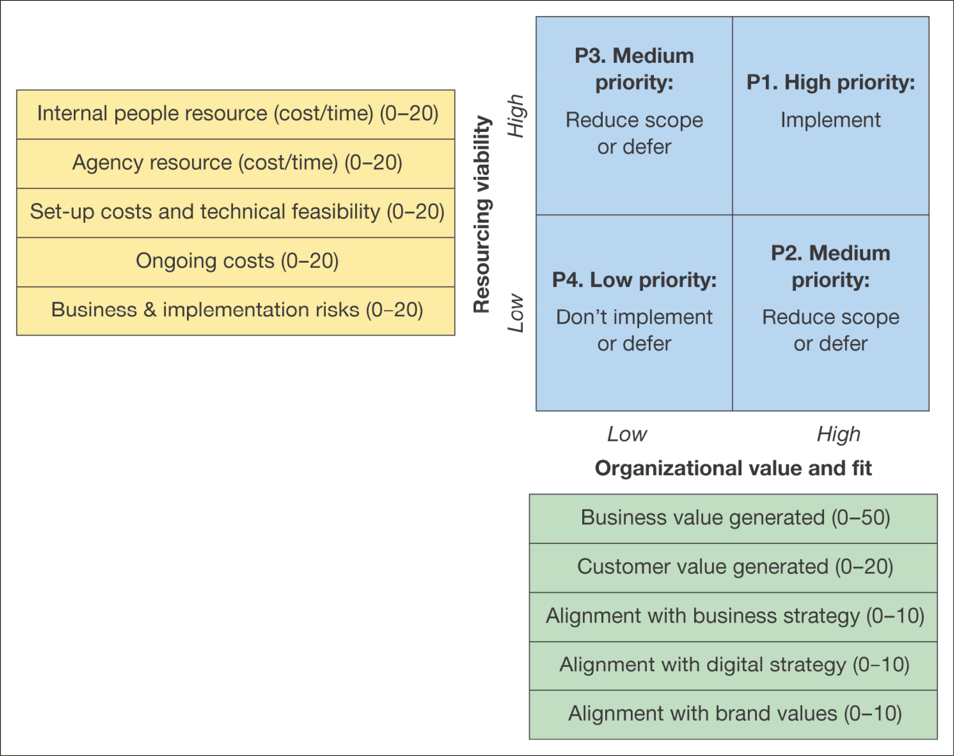
Portfolio Analysis:
Basis for bench marking current e-commerce capabilities and identifying strategic priorities
Matrix for evaluating digital business strategy alternatives
Source: E-consultancy (2008a)

Slide 23
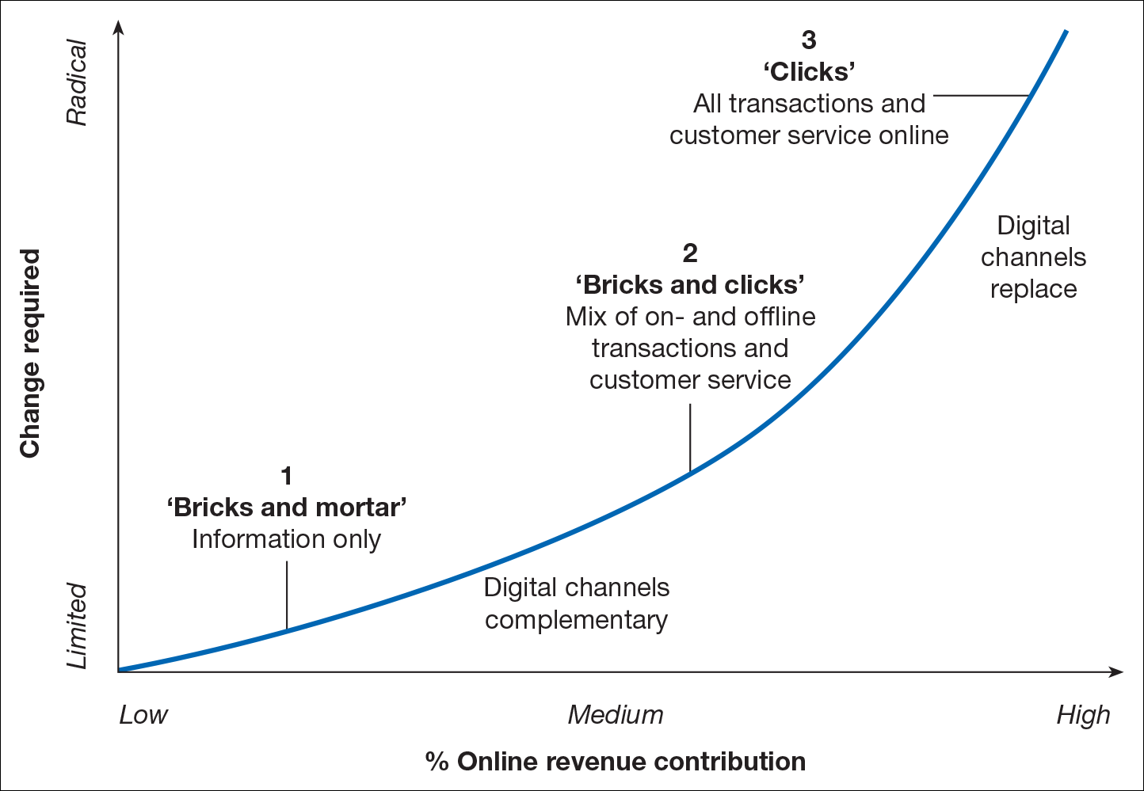
Eight key digital business strategic decisions
Decision 1:Digital business channel priorities
Figure 5.19 Strategic options for a company in relation to the importance of the Internet as a channel
Notes:
This slide is related with Decision 1
Diversification of digital platforms:
Investment and support for mobile applications
Investment in social media platform support

Slide 24
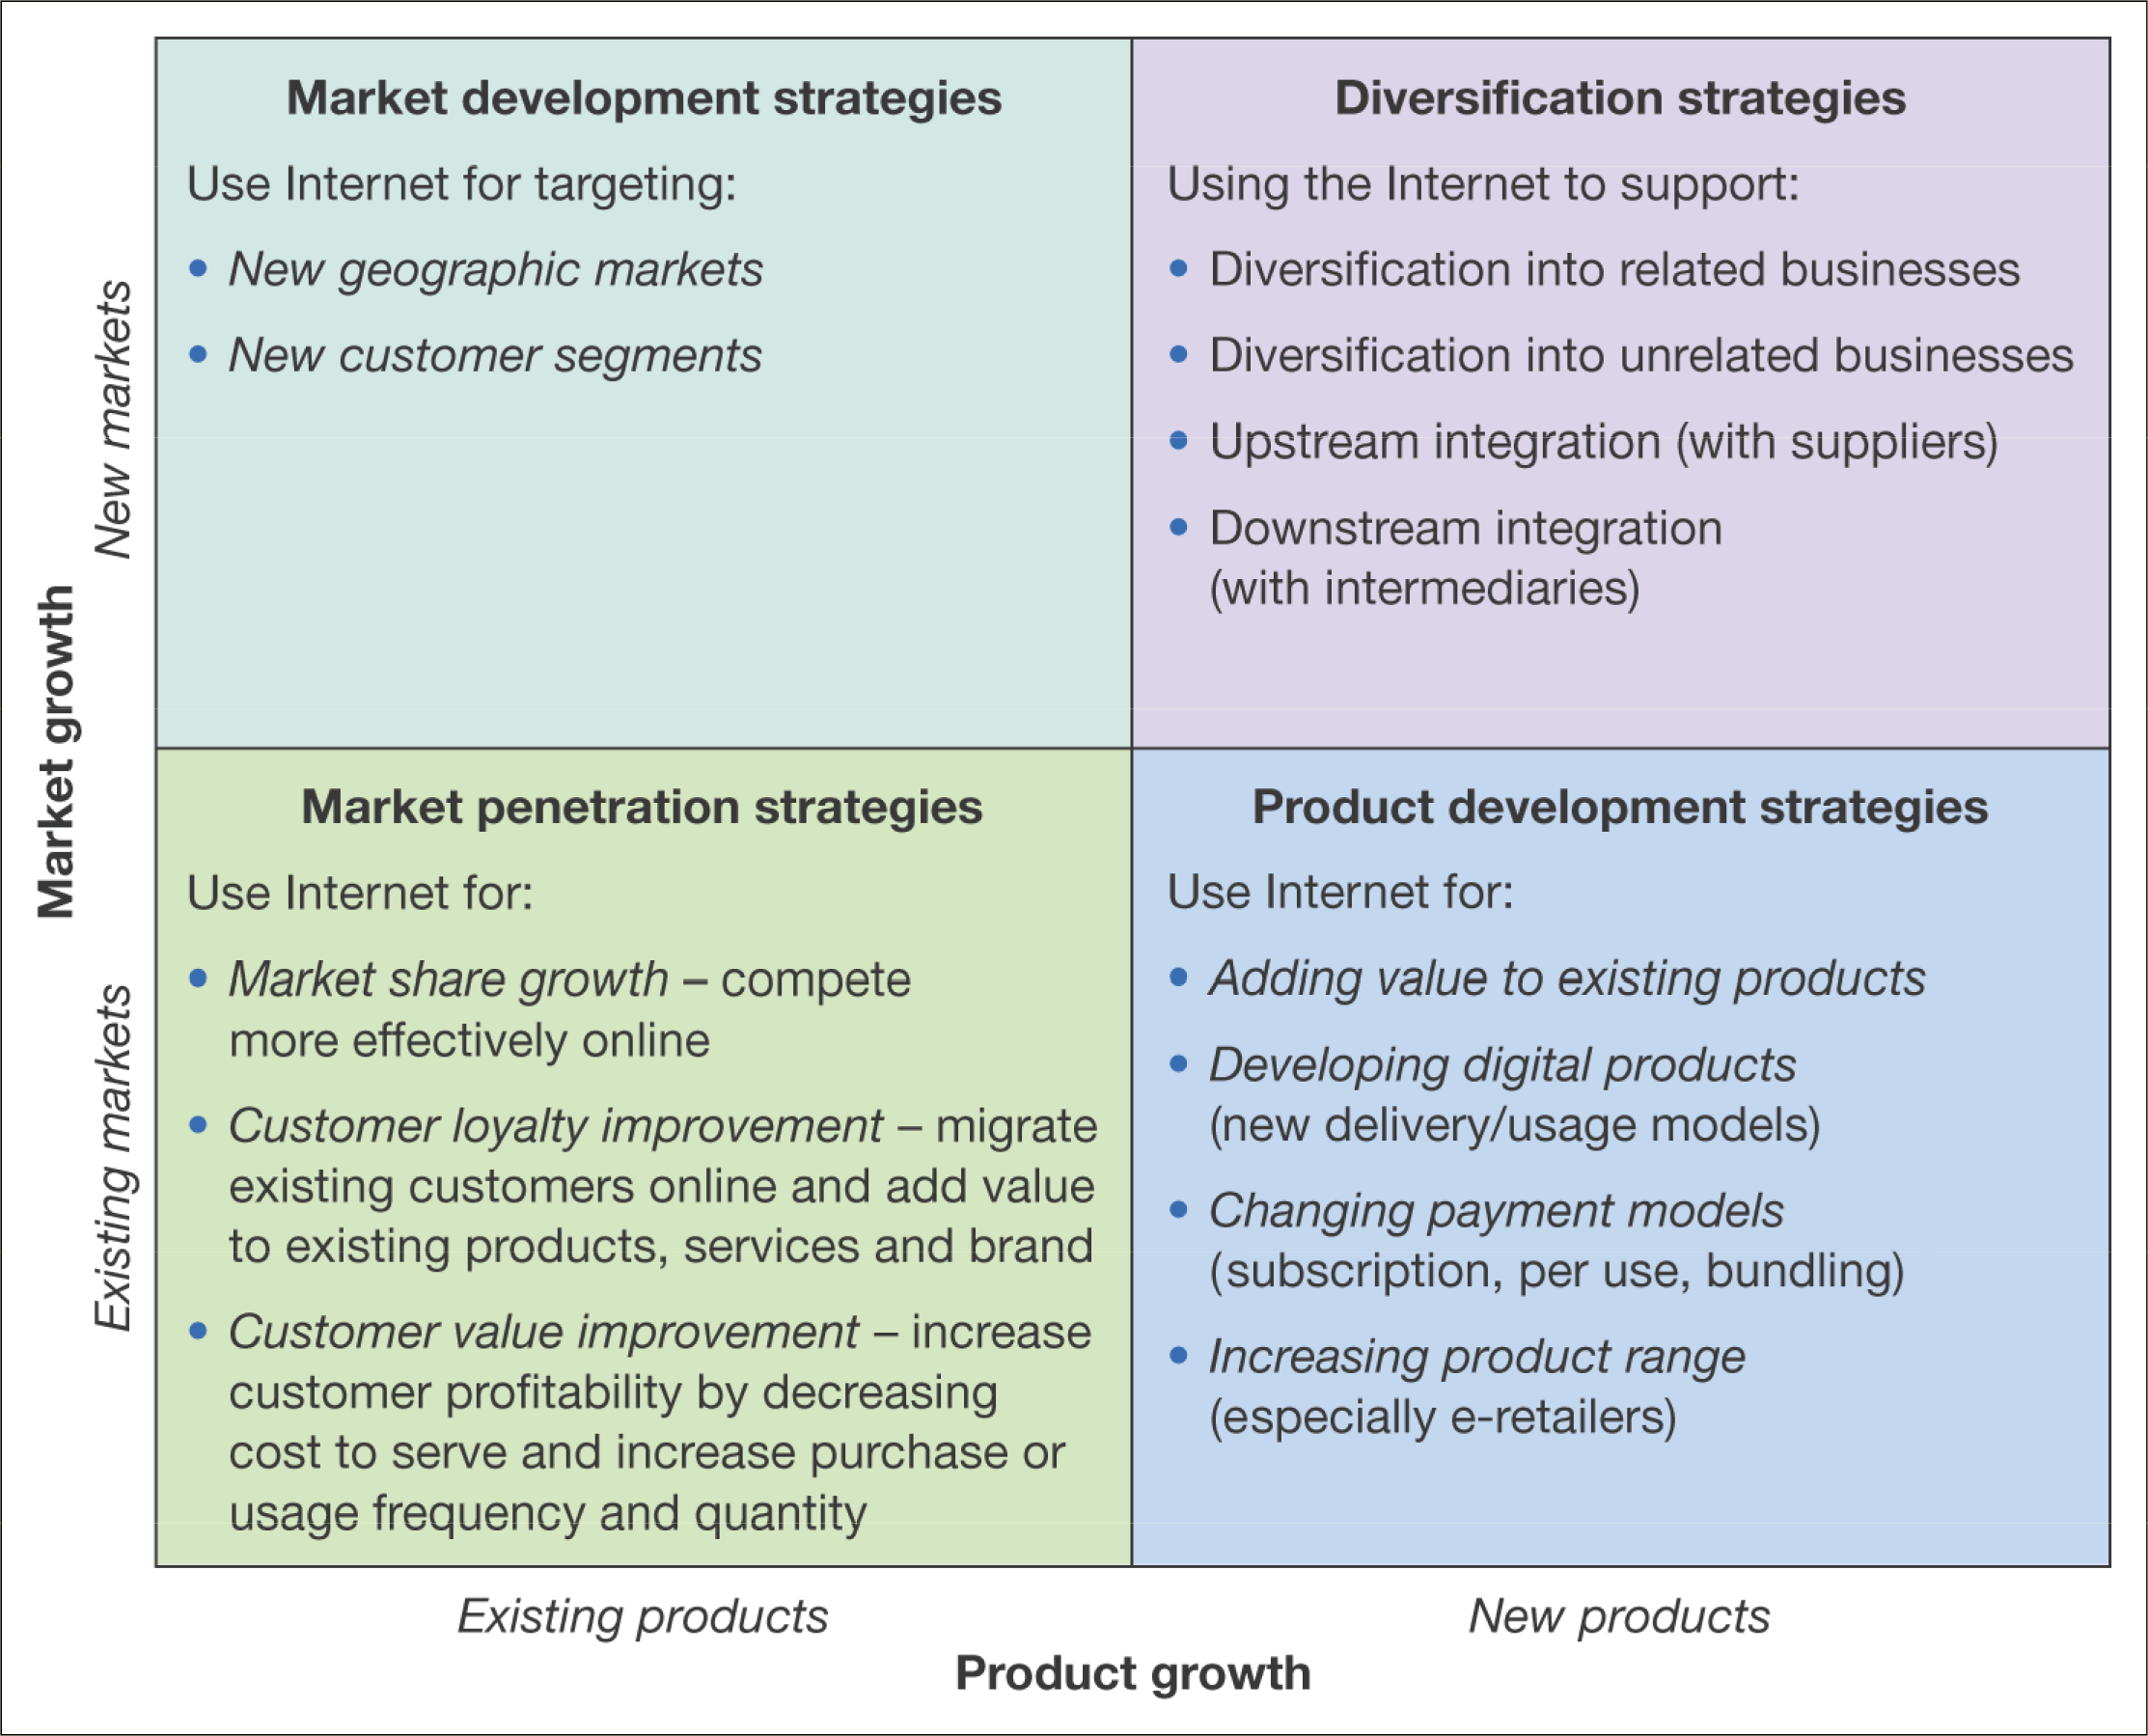
Eight key digital business strategic decisions
Decision 2:
Market and product development
Figure 5.20 Using the Internet to support different growth strategies
Notes:
This slide is related with decision 2

Slide 25
Eight key digital business strategic decisions
Decision 3: Positioning and differentiation strategies
Once market segments have been identified from decision 2, organisations need to define how to best position their online services relative to competitors according to 4 main variable:
Product quality,
service quality,
price and fulfilment time
The above could be achieved by enhancing:
Product performance excellence,
Price performance excellence,
Transactional excellence,
Relationship excellence
Decision 4: Business, service and revenue models
Constantly reviewing innovation in services to improve the quality of experience offered is also important for digital business

Slide 26
Eight key digital business strategic decisions
Decision 5: Marketplace restructuring
Digital communications offer opportunities for new market structures to be created through
disintermediation,
reintermediation and
Countermediation
Decision 6: Supply chain management capabilities
How should we (company) integrate closely with our suppliers?
Which types of materials and interactions with suppliers should we support through online procurement?
Can we participate in digital marketplace to reduce costs?

Slide 27
Eight key digital business strategic decisions
Decision 7: Internal knowledge management capabilities
How can our intranet be extended to support different business processes such as new product development, customer and supply chain management?
How can we disseminate and promote sharing of knowledge between employees to improve our competitiveness?
Decision 8: Organisational resourcing and capabilities
Once all the above 7 decisions have been reviewed and selected, decisions need to be made on how the organisation should change in order to achieve the priorities set for digital business

Slide 28
Eight key digital business strategic decisions
Organisational resources and capability should be reviewed:
Strategy process and performance improvement.
Structure. Location of e-commerce, hardware, software, staff skills
Senior management buy-in
Marketing integration. Staff responsible for technology and marketing need to work together more closely to achieve this
Digital marketing focus. Strategic initiatives will focus on customer acquisition, conversion, and retention
Partnering with other organisations. Some services will be best delivered through other companies.

Slide 29
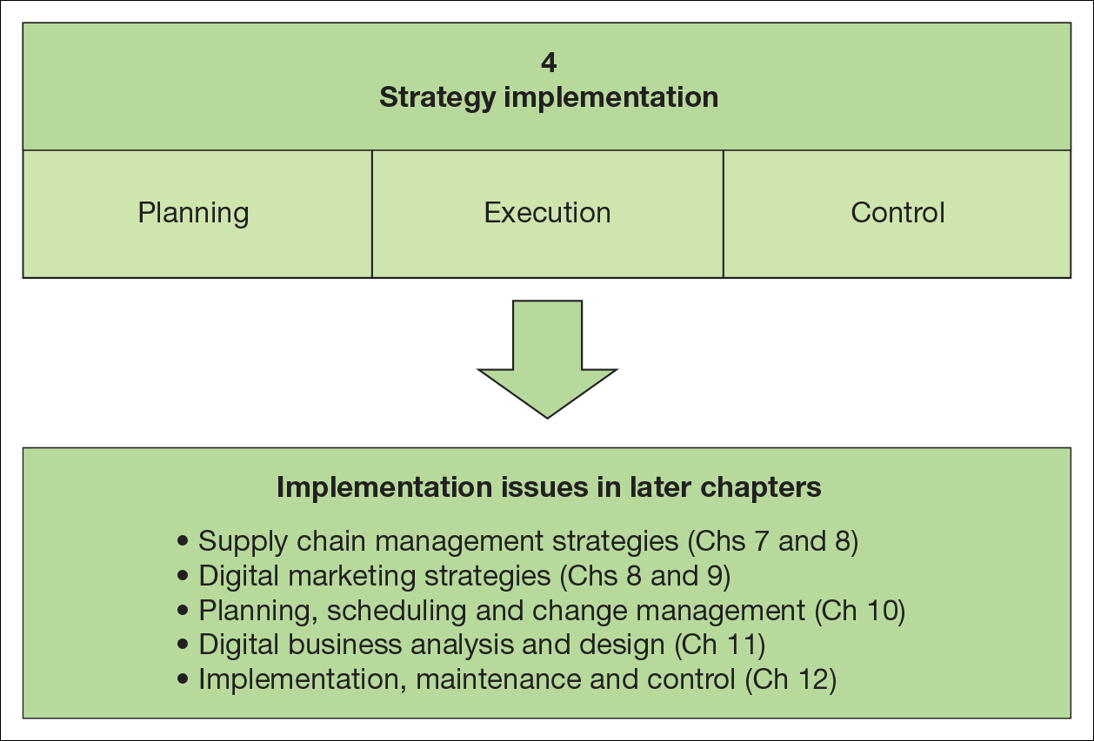
Figure 5.21 Elements of strategy implementation for the digital business

Slide 30
Boncheck, M. and Choudary S.P.(2013), Three elements of a Successful Platform Strategy. Harvard Business Review.
Hagel, J. (2015) The Power of Platforms. Accessed on 07 April 2020. Available at: https://www2.deloitte.com/global/en/insights/focus/business-trends/2015/platform-strategy-new-level-business-trends.html

